Slide 1

Web Scratch Tool Compare
Peter Huang
Moofon Lee
Notes:
1

Slide 2
Code by myself
1. Free
2. Custom-made
1. Spend time
2. Can't be apply in most of E-Commerce
Advantage
Disadvantage
Notes:
2

Slide 3
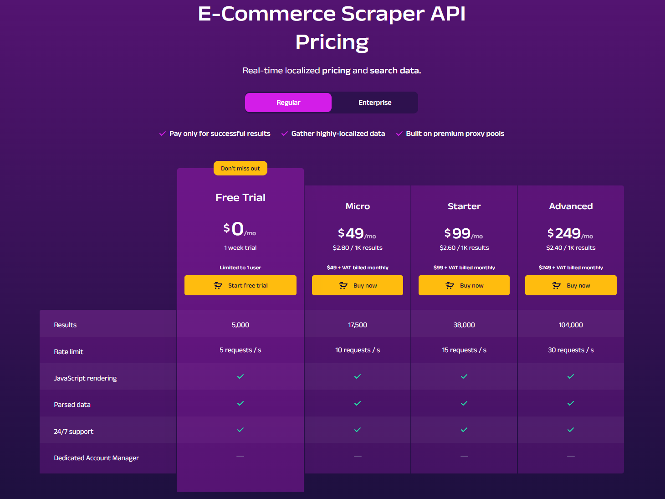
Oxylabs
Notes:
2

Slide 4
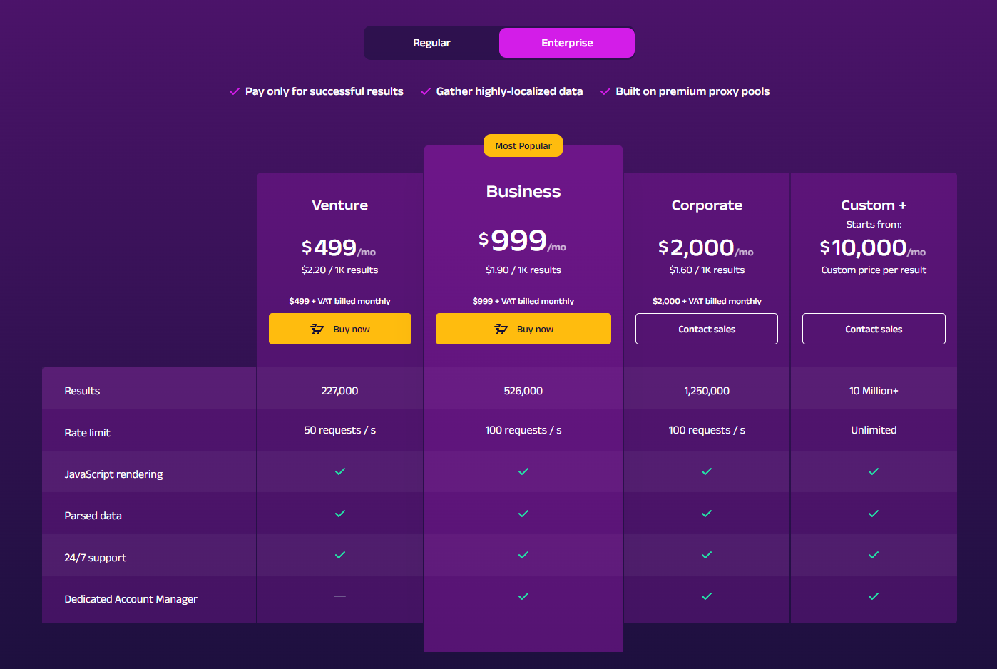
Oxylabs
Notes:
2

Slide 5
Oxylabs
1. Support most of internate E-Commerce
2. Can output result via Api (Easy to Connect)
3. All of the information from product can be scratch
Advantage
1. Expensive
2. Can't be apply in small or Asia E-Commerce
Disadvantage
Notes:
2

Slide 6
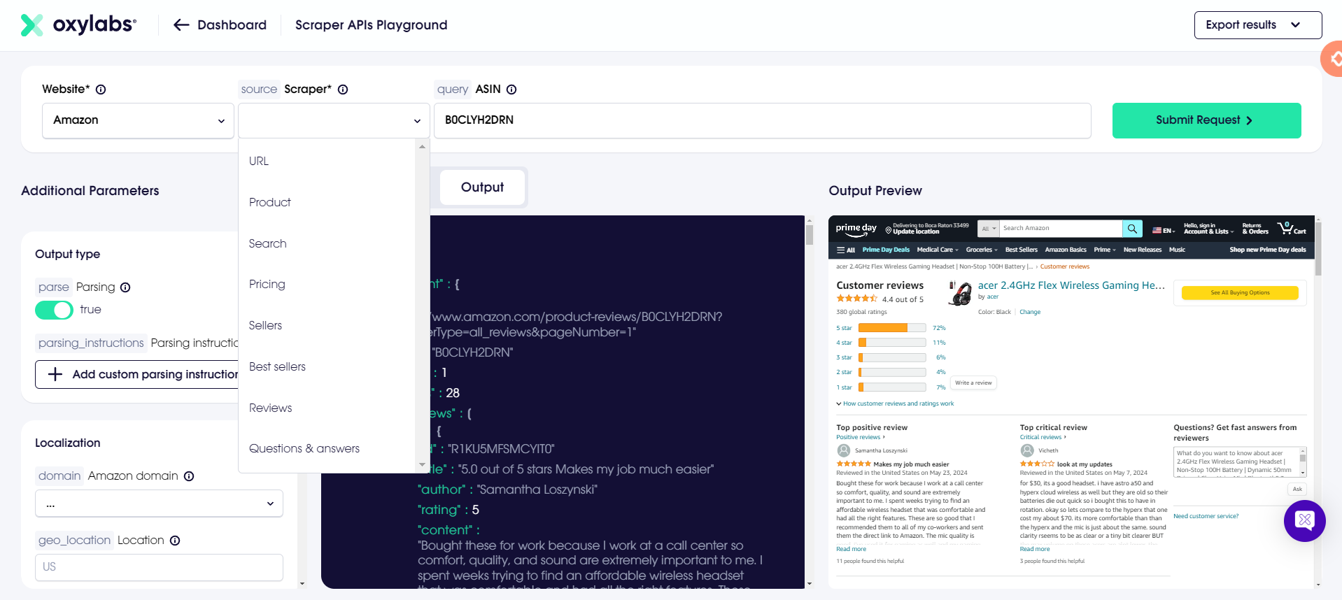
Oxylabs
Notes:
2

Slide 7
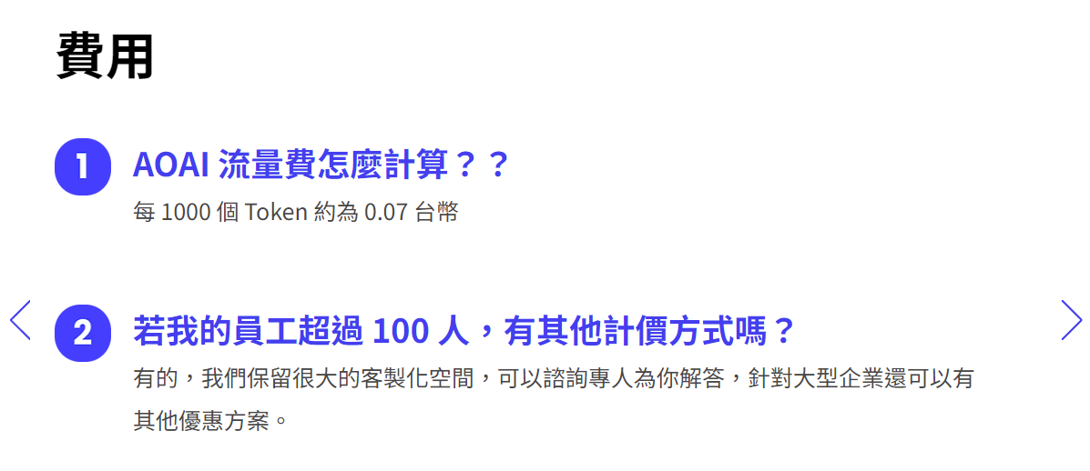
Bizbase.ai
Notes:
2

Slide 8
Bizbase.ai
Advantage
1. Usage billing
Disadvantage
1. It's for enterprise, need to write business information. So haven't test yet.
Notes:
2

Slide 9
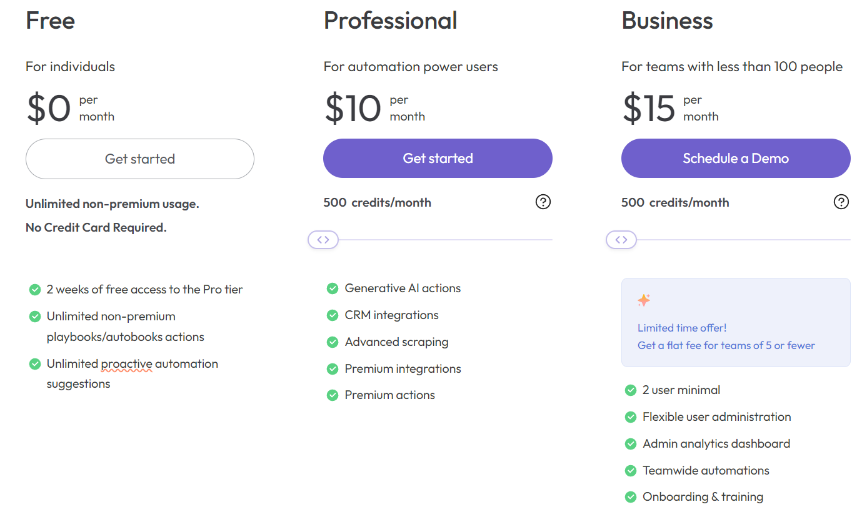
Bardeen
Notes:
2

Slide 10
Bardeen
1. Cheap
2. Run On Any Web Page
3. ChatGPT plugins
Advantage
1. Complex Operation (Have to made a template by yourself)
2. It's chrome extention, I'm not sure if it can integrate into code or call its api.
Disadvantage
Notes:
2

Slide 11
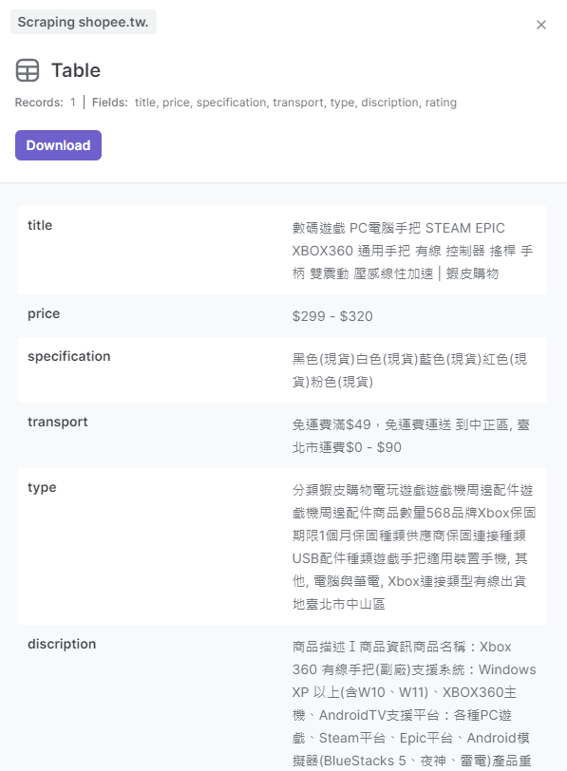
Bardeen
Notes:
2

Slide 12
Emily RPA
It's more like a operation robot. Not like web scratch.
Price: 36000TWD per year
Notes:
2

